Slide 1

Knowledge representation
Prof. Ahmad Hassanat
Dr. Ahmad Altarawneh

Slide 2
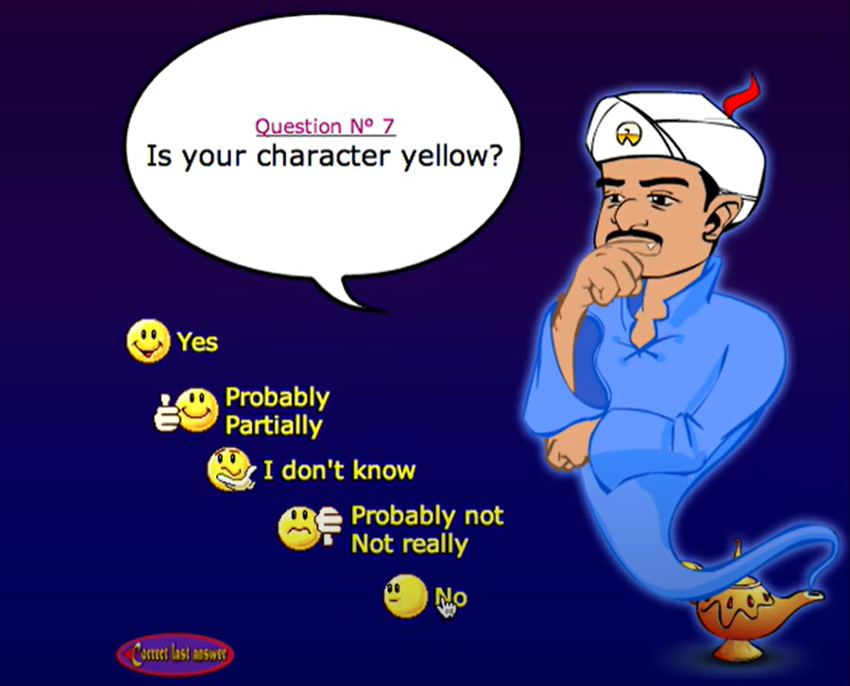
Knowledge representation
Knowledge representation’s fundamental goal is to represent knowledge in a manner that facilitates inferencing (i.e. drawing conclusions) from knowledge.
Mammals are animals
Dogs are mammals
We can conclude that Dogs are animals
This might look a simple example; however, the real-life applications will be more sophisticated than this
KR analyzes how to formally think - how to use a symbol system to represent a domain of discourse , along with functions that allow inference about the objects
https://ar.akinator.com/game

Slide 3
Cont.
Assumption of (traditional) AI is that:
Knowledge may be represented as “symbol structures” representing bits of knowledge (objects, concepts, facts, rules, strategies.. etc.).
E.g., “red” represents color red.
“car1” represents my car.
red(car1) represents fact that my car is red.
Intelligent behavior can be achieved through manipulation of symbol structures

Slide 4
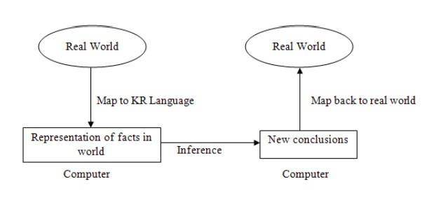
Well-defined syntax/semantics
Therefore, there should be an intermediate language that helps in representing knowledge in a structured form.
Knowledge representation languages should have precise syntax and semantics.

Slide 5

Main KR Approaches
Logic
Semantic Networks
Frames
Objects

Slide 6
Logic
A Logic is a formal language, with precisely defined syntax and semantics, which supports a sound inference. Independent of domain of application
Two types of logic for KR:
Propositional logic
Predicate logic
A proposition is a sentence which is true or false, and whichever is the case is called its truth value.
The moon made of cheese => the truth value is False (or F)
1+5=6 => we know that is correct, then the truth value is True (or T)

Slide 7
Propositional logic
In general, a logic is defined by
syntax: what expressions are allowed in the language
symbols => P, Q, R , P1, P2, etc.
Logical Constants T, F
Logical Operators ^, ->, <->
Semantics: what they mean, in terms of a mapping to real world
P might mean "the earth is round"
Q might mean "the earth is green"
P ^ Q => The earth is round, and the earth is green
proof theory: how we can draw new conclusions from existing statements in the logic.
Propositional logic is the simplest..

Slide 8
Propositional Logic: Syntax
Symbols or variables (e.g., letters, words) are used to represent facts about the world, e.g.,
“P” represents the fact “Andrew likes chocolate”
“Q” represents the fact “Andrew has chocolate”
These are called atomic propositions (cannot be divided into more parts)
Logical connectives are used to represent and: ∧ , or: ∨, if-then: → , not: ¬.
Statements or sentences in the language are constructed from atomic propositions and logical connectives
P ^ ¬Q: “Andrew likes chocolate, and he doesn’t have any.”
P → Q: “If Andrew likes chocolate, then Andrew has chocolate”

Slide 9
Propositional Logic: Semantics
What does it all mean?
Sentences in propositional logic tell you about what is true or false.
P ∧ Q Conjunction, means that both P and Q are true.
P ∨ Q Disjunction means that either P or Q is true (or both)
P → Q Conditional (implication): means that if P is true, so is Q.
P ↔ Q Equivalence The expression is true if and only if (iff) both P and Q have the same truth value (true or false)
This is all formally defined using truth tables.
p
q
p
∧
q
p
∨
q
p
→
q
p
↔
q
1
1
1
1
1
1
1
0
0
1
0
0
0
1
0
1
1
0
0
0
0
0
1
1

Slide 10
Examples
((Paris is the capital of UK) ∨ (3+2 < 3+9)) is true
((10 is divisible by 3) ∨ (7 ≤ 5)) is false
((7 is a prime number) ∧ (21+ 10 is odd)) is true
((8 is divisible by 7) ∧ (0=1)) is false
(If the Moon orbits Earth, then 5×3 = 3×5) is true
(If the sun rises from the west, then 5×3 > 3×5) is true
(If the sun rises from the east then 1+ 2 = 5) is false
(3 × 2 = 6 iff 15 >31 ) is false
(15 is a prime number iff 2 × 4 = 8) is true

Slide 11
Implication meaning
The implication (p -> q) might be the most confusing operator in logic
Here we explain it in some words
(T -> T) is true: because the first proposition is True, and the consequence is True as well
(T -> F) is false: because we are saying the condition is true (if part(, then q must be true for the whole statement to be true.
When the p is false (F -> T, F -> F), then regardless the value of q, the implication will give true. This because we are not connecting (we are not claiming a relationship) the first premise (p) with the second premise (q)
For example:
P: it is rainy
Q: hold an umbrella
If P is false then carrying umbrella (or not) will not affect the truth value of the whole statement, which is true.

Slide 12
Logical expressions
Propositions may contain more than one connectives.
e.g. It is cold or it is not snowing, and it is snowing.
The truth value of such propositions is determined by the truth table of their corresponding “logical expression”.
A logical expression is a meaningful string of variable proposition/predicate names and logical connectives.
e.g. (p∨ ¬ q)∧q corresponds to the above example
¬ (p∨ q)∧ ¬ r, ( ¬p ∧ q) → r, ¬ (p →q) ∨ ¬ p.
The truth table of logical expression is determined in the same way as algebraic expressions are calculated.

Slide 13
Example 1
1. The truth table of: (p∨ ¬ q) ∧ q
p
q
¬
q
(
p
∨
¬
q
)
(
p
∨
¬
q
)
∧
q
)
1
1
0
1
1
1
0
1
1
0
0
1
0
0
0
0
0
1
1
0
2. The truth table of: ¬ (p∨ q) ↔ ( ¬p ∧ ¬ q).
p
q
p
∨
q
¬
(
p
∨
q
)
¬
p
¬
q
(
¬
p
∧
¬
q
)
¬
(
p
∨
q
)
↔
(
¬
p
∧
¬
q
)
1
1
1
0
0
0
0
1
1
0
1
0
0
1
0
1
tautology
0
1
1
0
1
0
0
1
0
0
0
1
1
1
1
1

Slide 14
Example 2
The truth table of: (¬p ∧ q) → r.
p
q
r
¬
p
¬
p
∧
q
(
¬
p
∧
q)
→
r
1
1
1
0
0
1
1
1
0
0
0
1
1
0
1
0
0
1
1
0
0
0
0
1
0
1
1
1
1
1
0
1
0
1
1
0
0
0
1
1
0
1
0
0
0
1
0
1
Note that the table consist of 8=2³ rows

Slide 15
Logical equivalence
In example (1), the two sub-expressions ¬ (p∨ q) and (¬p ∧ ¬ q) have identical truth tables.
Two expressions A and B (having the same variable names) are logically equivalent if they have the same truth value for every combination of truth values of the variable propositions. In this case, we write A ≡ B.
Hence: ¬ (p∨ q) ≡ (¬p ∧ ¬ q) … (De Morgan’s Law)
We also note form example 1.2, that ¬(p∨ q)↔(¬p ∧ ¬ q) is always true. Such an expression is called a tautology.
A contradiction is an expression that is always false.
For example, (p ∧ ¬ p) is a contradiction for any p.

Slide 16
Example 3
Show that: p ∧ (q ∨ r) ≡ (p ∧ q) ∨ (p ∧ r)
p
q
r
q
∨
r
p
∧
(q
∨
r)
p
∧
q
p
∧
r
(
p
∧
q
)
∨
(p
∧
r)
1
1
1
1
1
1
1
1
1
1
0
1
1
1
0
1
1
0
1
1
1
0
1
1
1
0
0
0
0
0
0
0
0
1
1
1
0
0
0
0
0
1
0
1
0
0
0
0
0
0
1
1
0
0
0
0
0
0
0
0
0
0
0
0

Slide 17
Logical equivalence - continued
De Morgan’s Law (i.e. ¬ (p∨ q) ≡ (¬p ∧ ¬ q) ) can be used to simplify the negation of compound propositions.
e.g. The negation of the proposition:
( 3 + 5 = 7 or the Moon orbits the Sun)
is (3 + 5 ≠ 7 and the Moon does not orbit the sun).
Another important logical equivalence is:
¬ (¬ (p)) ≡ p … (double negation)
The double negation rule can be used to obtain another version of De Morgan’s Law:
¬ (¬ p ∧ ¬ q) ≡ (p ∨ q).
¬ (¬ p∨ ¬ q) ≡ (p ∧ q)

Slide 18
Laws of Logic
(p ↔ q) ≡ (p→ q) ∧ (q → p) … (Equivalence law)
(p→ q) ≡ (¬p ∨ q) … (Implication law)
¬ (¬ (p)) ≡ p … (Double negation)
(p ∧ p) ≡ p & (p ∨ p) ≡ p … (Idempotent law)
(p ∧ q) ≡ (q ∧ p) & (p ∨ q) ≡ (q ∨ p) … (Commutative)
p ∧ (q ∧ r) ≡ (p ∧ q ) ∧ r &p ∨ (q ∨ r) ≡ (p ∨ q ) ∨ r … (Associative law)
¬ (p∨ q) ≡ (¬p ∧¬ q) & ¬(p ∧ q) ≡ (¬p ∨¬ q) … (De Morgan)
p ∧ (q ∨ r) ≡ (p ∧ q ) ∨ ( p ∧ r ) & p ∨ (q ∧ r) ≡ (p ∨ q ) ∧ ( p ∨ r ) … (Distributive law)
p ∧ (p ∨ q) ≡ p & p ∨ (p ∧ q) ≡ p … (Absorption law)
p ∧ ¬ p ≡ F & p ∨ ¬ p ≡ T … (Inverse law)
p ∧ T ≡ p ≡ p ∨ F p ∧ F ≡ F & p ∨ T ≡ T

Slide 19
Example 4
The previously mentioned laws can be used for expressions simplification
Consider the expression: A = ¬ ((p→ q) ∧ ¬ (p ∧ q))
By the laws of logic,
A ≡ ¬ (p→ q) ∨ ¬ ( ¬ (p ∧ q))
≡ ¬(¬ p ∨ q) ∨ (p ∧ q) ≡ (p ∧ ¬ q) ∨ (p ∧ q)
≡ p ∧ (¬ q ∨ q)
≡ p ∧ T ≡ p

Slide 20
Another example
Assume having the following expression:
(p ∧ (p → q)) → q
Using logic laws:
Step 1: (p ∧ (¬p ∨ q)) → q
Step 2: ((p ∧ ¬p) ∨ (p ∧ q)) → q
Step 3: (F ∨ (p ∧ q)) → q
Step 4:(p ∧ q) → q
Step 5: ¬(p ∧ q) ∨ q
Step 6:(¬p ∨ ¬q) ∨ q
Step 7: ¬p ∨ (¬q ∨ q)
Step 8: ¬p ∨ T
Step 9: T
This expression is tautology: which means it can be used as an inference rule
i.e.,
if p is true (we have it in our knowledge base)
And the term (p → q),
then we can conclude that q must be true as well

Slide 21
Equivalence
Also, logic laws can be used as alternative to truth table to prove the equivalence of logical expressions
p→ (q ∧ r) ≡ (p→ q) ∧ ( p→ r)
Can we prove the logical equivalence of the above expressions?
p→ (q ∧ r)
¬ p ∨ ( q ∧ r)
(¬ p ∨ q) ∧ (¬ p ∨ r)
(p→ q) ∧ ( p→ r)

Slide 22
Exercises
Use the laws of logic to prove the following equivalences:
1. (p→ q) ≡ ( ¬ q→ ¬ p)
2. (p ∧ q) → r ≡ p→ (q→ r)
Answers:
p→ q ≡ ¬ p ∨ q
≡ q ∨ ¬ p
≡ ¬ ( ¬ q) ∨ ¬ p
≡ (¬ q→ ¬ p)
2. (p ∧ q) → r ≡ ¬ ( p ∧ q ) ∨ r
≡ ( ¬ p ∨ ¬ q ) ∨ r
≡ ¬ p ∨ ( ¬ q ∨ r )
≡ ¬ p∨ (q→ r)
≡ p→ (q→ r)

Slide 23
Proof Theory ~ some inference rules
modus ponens rule:
If A is true and A → B is true, then conclude B is true.
If you did not sleep last night, you will sleep during the lecture.
* You did not sleep last night
We can conclude that you will sleep during the lecture.
A, A → B
—————————
B

Slide 24
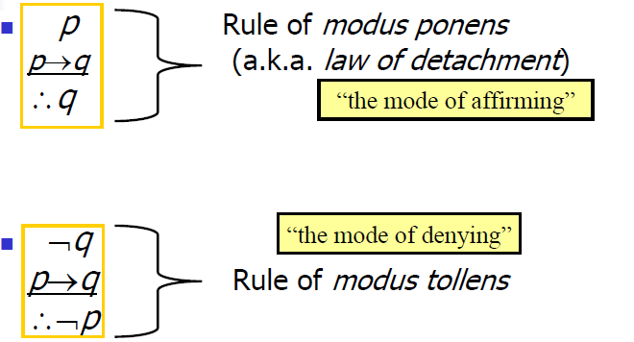
Cont.

Slide 25
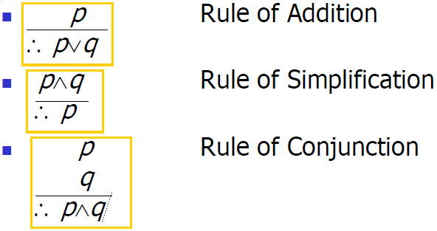
Cont.

Slide 26
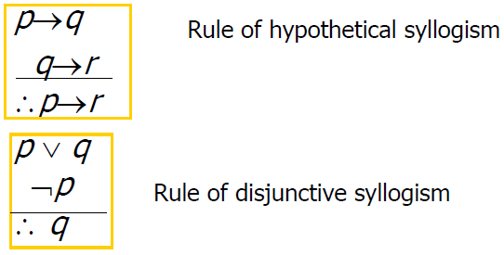
Cont.

Slide 27
Proof Theory and Inference
So, let P mean “It is raining”, Q mean “I carry my umbrella”.
If we know that P is true, and P → Q is true..
We can conclude that Q is true.
Note that certain expressions are equivalent
think about P → Q and ¬ P v Q

Slide 28
Example
Assume you have the following facts in our KB:
If tomorrow is sunny, we will go canoe
If we canoe, then we will visit the sea
if we visit the see, then we will go home early
Tomorrow it is windy, or it is sunny
Tomorrow it is not windy
Can we infer that we will go home early? using which rules

Slide 29
More complex rules of inference
Other rules of inference can be used, e.g.,:
This is essentially the resolution rule of inference, used in Prolog.
Consider:
What can we conclude?
P v Q, ¬ Q v R
———————————————
P v R
sunny v raining
¬ raining v ground is wet

Slide 30
Resolution algorithm
Suppose we want to try and prove that a certain proposition is true, given some sentences that are true.
It turns out that the resolution rule is sufficient to do this.
There are some steps for the resolution algorithm:
Convert the statements to their equivalent logical expressions
Eliminate the implications: P → Q becomes ¬ P v R
Convert to conjunctive normal form (CNF): conjunction of disjunctions
{(PvQ) ∧ (RvS) ∧ (RvS)}
Negate the goal (the statement to be proved) and perform elimination until there is no remaining clauses in the KB
If you remains with empty KB then the goal is true otherwise it is false

Slide 31
More examples
More examples and explanation can be found here:
https://www.youtube.com/watch?v=9gH2obkkUCI
https://www.youtube.com/watch?v=PMm5Mat0MRA

Slide 32
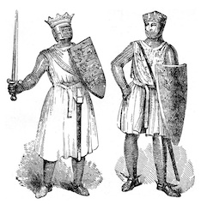
PL for puzzles (Self Study)
Propositional logic can be used for solving logical puzzles
One of the popular puzzles is called Knights and Knaves problem
You have two people (might be more),
one of them is a Knight: always tells the truth (never lies)
The second one is a Knave: never tells the truth (always lies)
You approached to each one of them and they told you the following
A says: B is a Knave
B says: we are both nights
Who is the Knave and who is the knight, based on their statements?

Slide 33
Cont.
To solve this we can use the PL and truth tables.
We assume that both are knights
A: Knight T
B: Knight T
Convert their statements to PL
A says: B is a Knave => ¬B
B says: we are both nights types => A ^ B
Build a truth table with their statements to see if there is a contradiction
A | B | ¬B | A^B
T | T | F | T
T | F | T | F
F | T | F | F
F | F | T | F

Slide 34
Cont.
Now, we can check the contradictions using biconditional statements
A is Knight (T) if and only if his statement gives T
A is Knave (F) if and only if his statement gives F
Same for B
A | B | ¬B | A^B
T | T | F | T
T | F | T | F
F | T | F | F
F | F | T | F

Slide 35
Cont.
Now, we can check the contradictions using biconditional statements
A is Knight (T) if and only if his statement gives T
A is Knave (F) if and only if his statement gives F
Same for B
A | B | ¬B | A^B
T | T | F | T
T | F | T | F
F | T | F | F
F | F | T | F
¬B <-> A | (A ^ B) <-> B
F | T
T | T
T | F
F | T

Slide 36
Cont.
Now, we can check the contradictions using biconditional statements
A is Knight (T) if and only if his statement gives T
A is Knave (F) if and only if his statement gives F
Same for B
A | B | ¬B | A^B
T | T | F | T
T | F | T | F
F | T | F | F
F | F | T | F
¬B <-> A | (A ^ B) <-> B
F | T
T | T
T | F
F | T
Therefore A is a Knight
B is a Knave

Slide 37
Example
We have three islanders
A: C is a knight, if and only if B is a knight. => C <-> B
B: C is a knave or A is a knave. => ¬C ∨ ¬A
A | B | C | C <-> B | ¬C | ¬A | ¬C ∨ ¬A
T | T | T | T | F | F | F
T | T | F | F | T | F | T
T | F | T | F | F | F | F
T | F | F | T | T | F | T
F | T | T | T | F | T | T
F | T | F | F | T | T | T
F | F | T | F | F | T | T
F | F | F | T | T | T | T

Slide 38
Therefore A is a Knave
B is a Knight
C is a Knave
A | B | C | C <-> B | ¬C | ¬A | ¬C ∨ ¬A
T | T | T | T | F | F | F
T | T | F | F | T | F | T
T | F | T | F | F | F | F
T | F | F | T | T | F | T
F | T | T | T | F | T | T
F | T | F | F | T | T | T
F | F | T | F | F | T | T
F | F | F | T | T | T | T
(C <-> B) <->A
T
F
F
T
F
T
T
F
B <-> (¬C ∨ ¬A)
F
T
T
F
T
T
F
F

Slide 39
Exercise
A:If B is a knave, then C is a knave.
B: C is a knight and A is a knave

Slide 40
Predicate Logic
Propositional logic isn’t powerful enough as a general knowledge representation language.
The assertion "x is greater than 1", (where x is a variable), is not a proposition because you can not tell whether it is true or false unless you know the value of x
Impossible to make general statements. E.g., “all students are smart” in a domain like a university.
There is no ability to quantify or reason about individuals within a group
If 100 students are smart, we need to write a proposition for each one stating that it is smart
i.e. Propositional logic lacks quantifiers (∀ all, ∃ exist,..) and variables
Thus, we need more powerful logic to deal with these and other problems. The predicate logic is one of such logic and it addresses these issues among others

Slide 41
Cont.
A predicate is a verb phrase template that describes a property of objects, or a relationship among objects represented by variables.
E.g. “my car is blue", "The sky is blue", and "The sea is blue“: "is blue" is a predicate and it describes the property of being blue.
If we adopt B as the name for the predicate "is blue", sentences that assert an object is blue can be represented as "B(X)", where X represents an object.
B(X) reads as "x is blue"

Slide 42
Cont.
In predicate logic the basic unit is a predicate/ argument structure called an atomic sentence:
likes(alison, chocolate)
tall(fred)
Arguments can be any of:
constant symbols, such as ‘alison’
variable symbols, such as X (should be capital letters, or starts with a capital letter)
functions, e.g., motherof(nancy)
predicates, e.g., friend(sam,ram)
So, we can have:
likes(X, richard)
friends(motherof(joe), motherof(jim))

Slide 43
Cont.
These atomic sentences can be combined using logic connectives
likes(john, mary) → tall(mary)
tall(john) → nice(john)
Sentences can also be formed using quantifiers ∀ (for all) and ∃ (there exists) to indicate how to treat variables:
∀ X lovely(X) Everything is lovely.
∃ X lovely(X) Something is lovely.
∀ X in(X, garden) → lovely(X) Everything in the garden is lovely.
Note: ∀X ∃X ≠ ∃X ∀X
∃X ∀Y: There is one person who loves everyone on Earth
∀X ∃Y: Everyone on Earth is loved by at least one person

Slide 44
Cont.
Can have several quantifiers, e.g.,
∀X ∃Y loves(X, Y)
∀X ∃Y handsome(X) → loves(Y, X)
So we can represent things like:
All men are mortal.
No person likes potato.
Everyone study will pass his exams.
Every race has a winner.
John likes everyone who is tall.
John doesn’t like anyone who likes potato.
There is something small and slimy on the table
∀X man(X) → mortal(X)
∀x person(X) → ¬likes(X, potato)
∀X study(X) → pass(X)
∀X ∃Y race(X) → Wins(Y, X)
∀X tall(X) → likes(john, X)
∀X likes(X, potato) → ¬likes(john,X)
∃X ontable(small(X) ^ slimy(X))

Slide 45
Semantics
There is a precise meaning to expressions in predicate logic.
Like in propositional logic, it is all about determining whether something is true or false.
∀ X P(X) means that P(X) must be true for every object X in the domain of interest.
∃ X P(X) means that P(X) must be true for at least one object X in the domain of interest.
So, if we have a domain of interest consisting of just two people, john and mary, and we know that tall(mary) and tall(john) are true, we can say that ∀ X tall(X) is true.

Slide 46
Proof and Inference
What can we conclude from the following?
∀ X tall(X) → strong(X)
tall(john)
∀ X strong(X) → loves(mary, X)

Slide 47
Proof and inference
Again, we can define inference rules allowing us to say that if certain things are true, certain other things are sure to be true, e.g.
∀ X P(X) → Q(X) P(something) ----------------- (so we can conclude) Q(something)
This involves matching P(X) against P(something) and binding the variable X to the symbol something.

Slide 48
Prolog and Logic
All this should remind us of Prolog..
Prolog is based on predicate logic, but with slightly different syntax.
a(X) :- b(X), c(X). Equivalent to
∀ X a(X) → b(X) ∧ c(X) Or equivalently
∀ X b(X) ∧ c(X) → a(X)
Prolog has a built in proof/inference procedure, that lets you determine what is true given some initial set of facts. Using the “resolution” Proof method

Slide 49
Prolog
Rules:
fred likes someone if that someone is tall.
A person examines a course if they teach that course.
NOTE: “:-” used to mean IF. Meant to look a bit like a backwards arrow
NOTE: Use of capitals (or words starting with capitals) for variables.
likes(fred, X) :- tall(X).
examines(Person, Course) :- teaches(Person, Course).

Slide 50
Prolog
Your “program” consists of a file containing facts and rules.
You “run” your program by asking “questions” at the prolog prompt.
fred likes who?
Answers are then displayed. Type “;” to get more answers: (Note: darker font for system output)
|?- likes(fred, X).
X = john ? ;
X = sue ? ;
no

Slide 51
Prolog and Search
Prolog can return more than one answer to a question.
It has a built in search method for going through all the possible rules and facts to obtain all possible answers.
Search method “depth first search” with “backtracking”.

Slide 52
Other Logics
Predicate logic is not powerful enough to represent and reason on things like time, beliefs, and possibilities.
“He may do X”
I believe he should do X.
Specialized logics exist to support reasoning on this kind of knowledge.

Slide 53
Other Knowledge Representation Methods
Logic isn’t the only method of representing knowledge.
There are other methods which are less general, but more natural, and arguably easier to work with:
Semantic Nets
Frames
Objects
To some extent modern OOP has superseded the first two, with the ability to represent knowledge in the object structures of your programming language.

Slide 54
Semantic Nets etc..
Semantic nets, frames and objects all allow you to define relations between objects, including class relations (X isa Y).
Only restricted inference supported by the methods - that based on inheritance.
1. All birds can fly. (Inheritance: If X is a bird, X can fly)
2. Penguins are birds. (Inheritance: Penguins inherit properties from birds)
So.. Fido is a dog, dogs have 4 legs, so Fido has 4 legs.

Slide 55
Semantic Net
A long existing notion: there are different pieces of knowledge of world, and they are all linked together through certain semantics.
knowledge is expressed as a collection of concepts, represented by nodes (shown as boxes in the diagram), connected together by relationships, represented by arcs (shown as arrows in the diagram).
certain arcs - particularly isa arcs - allow inheritance of properties.
Basic Components
Nodes
Represent concepts
Arcs
Represent relations
Labels for nodes and arcs
student
IS-A
hasan
FRIEND-OF
AGE
21
rita

Slide 56
Example: The Queen Mary is an ocean liner. Every ocean liner is a ship
Semantic Net
Common arcs used for representing hierarchies include isa and has-part.
ship
IS-A
Ocean_liner
IS-A
Queen_mary

Slide 57
Semantic Net …..
Common arcs used for representing hierarchies include isa and has-part.
HAS-PART
IS-A
SHIP
IS-A
HAS-PART
Ocean Liner
Oil Tanker
Engine
Hull
IS-A
IS-A
HAS-PART
HAS-PART
Swimming
Pool
Queen Mary
Liver Pool
Boiler

Slide 58
Semantic Networks- example
Knowledge represented as a network or graph
haspart
Animal
head
subclass
subclass
Reptile
Mammal
subclass
livesin
Africa
Elephant
large
size
instance
Nellie
apples
likes

Slide 59
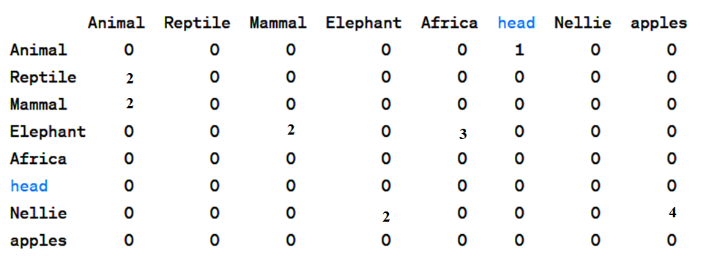
Using adjacency matrix
Here we use only one relation for illustration
The numbers should represent the relations
For example, 1=> has a (animals has head
2 is a, a mammal is an animal
3 lives in, Elephant lives in Africa
4 Likes, etc.

Slide 60
Semantic Networks
By traversing network we can find:
That Nellie has a head (by inheritance)
That certain concepts related in certain ways (e.g., apples and elephants).
BUT: Meaning of semantic networks was not always well defined.
Are all Elephants big, or just typical elephants?
Do all Elephants live in the “same” Africa?
Do all animals have the same head?
For machine processing these things must be defined.

Slide 61
Major Limitations
Lack of Semantics
No formal semantic of the relations
E.g. Does “ISA” mean subclass, member, etc?
Possible multiple interpretations
Restricted expressiveness
E.g. can not distinguish between instance and class
Example: Maxi ISA Dog => is Maxi a breed of dogs or a dog called Maxi
Advantages:
Easy to follow hierarchy, easy to trace association, flexible
Disadvantages:
Meaning attached to nodes might be ambiguous
exception handling is difficult
difficult to program (not really)
search is very inefficient, because it is not knowledge-guided: Might search for large amount of irrelevant information before getting to the goal (large search before we know that Nellie likes apple

Slide 62
Frames
A data structure for representing a stereotype situation
stereotyped: refers to typical scenarios or contexts that are represented by a set of expected attributes, actions, and outcomes that are commonly associated with them
A network of nodes and relations organized in a hierarchy
The topmost nodes - general concepts
The lower nodes - more specific instances
The idea of frame hierarchies is very similar to the idea of class hierarchies found in object-orientated programming.

Slide 63
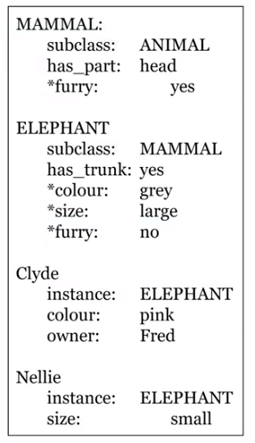
Frames
Frames were the next development, allowing more convenient “packaging” of facts about an object. Frames look much like modern classes, without the methods:
We use the terms “slots” and “slot values”
mammal:
subclass: animal
elephant:
subclass: mammal
size: large
haspart: trunk
Nellie:
instance: elephant
likes: apples

Slide 64
Frames
Frames often allow you to say which things were just typical of a class, and which were definitional, so couldn’t be overridden. Using an asterix to denote typical values:
Frames also allow multiple inheritance (Nellie is an Elephant and is a circus animal). Introduces problems in inheritance.
Elephant:
subclass: mammal
haspart: trunk
* colour: grey
* size: large

Slide 65
How Frames are Organized
A frame system is a hierarchy of frames
Each frame has:
a name.
slots: these are the properties of the entity that has the name, and they have values. A particular value may be:
a default value
an inherited value from a higher frame
a procedure to find a value
In the higher levels of the frame hierarchy, typical knowledge about the class is stored.
The value in a slot may be a range or a condition.
In the lower levels, the value in a slot may be a specific value, to override the value which would otherwise be inherited from a higher frame.

Slide 66
Example: A car has 4 wheels, is moving by an engine, and runs on petrol or diesel.
We can now add three slots to the frame.
The last of these has a restriction rather than a specific value.
Name: car Subclass of: thing
car subclass_of
thing
with
wheels: 4,
moved_by: engine,
fuel:
[value:
unknown,
type:
[petrol,diesel]].
Slots:
Name: Value: Restrictions:
wheels 4
moved by engine
fuel ? petrol or diesel

Slide 67
“There is a particular type of car called Toyota, manufactured in Japan.”
We can add a second frame to our system, with one slot. We don’t need to repeat the slots and values in the previous frame: they will be inherited.
‘Toyota’ subclass_of
car
with
made_in:
‘Japan’.
Name: Toyota Subclass of: car
Slots:
Name: Value: Restrictions:
made in Japan

Slide 68
“There is a particular type of Golf called a TDi, which runs on diesel, has 4 cylinders, and has a 1.8 litre engine.”
Name: TDi Subclass of: Golf
‘TDi’ subclass_of
‘Golf’
with
fuel: diesel,
engine_capacity:
1.8,
cylinders: 4.
Slots:
Name: Value: Restrictions:
fuel diesel
engine capacity 1.8 litres
cylinders 4

Slide 69
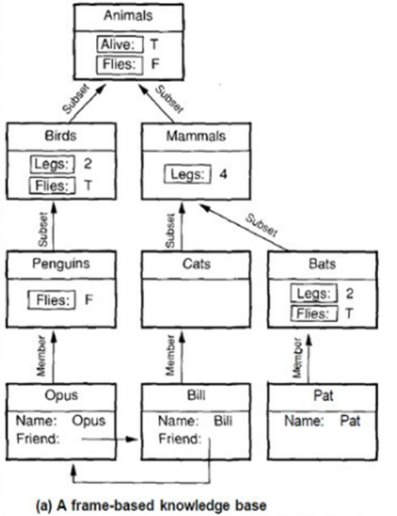
Example: Animal Zoo

Slide 70
Frames and procedures
Frames often allowed slots to contain procedures.
So.. Size slot could contain code to run to calculate the size of an animal from other data.
Sometimes divided into “if-needed” procedures, run when value needed, and “if-added” procedures, run when a value is added (to update rest of data, or inform user).
Find a valid booking dates (calculated by a procedure when needed)
Or calculate the cost of a trip when a destination is selected
When a vacation date is added, the available dates for booking will be updated
So.. Similar, but not quite like modern object-oriented languages.

Slide 71
Frames …
Advantages:
Expressive power, easy to set up slots for new properties and relations
easy to create specialized procedures
easy to include default information and detect missing values
Disadvantages:
Difficult to program (easier in OOP-based languages)
Difficult for inference (depending on the system and domain)
Sometimes we do not want some properties of the super class to be inherited by the subclass
Failing in handling exceptions will result in misleading inference

Slide 72
Summary
Intelligent systems require that we have
Knowledge formally represented
New inferences/conclusions possible.
Formal languages have been developed to support knowledge representation.
One important method is the use of logic - very general-purpose way to formally represent facts about the world, and draw sound conclusions from these.

Slide 73
Summary - cont
Predicate logic provides well defined language for knowledge rep supporting inference.
Frames/Networks/Objects more natural, but only explicitly support inheritance, and may not have well defined semantics.
Current trend is either to just use OO, or to use logic, but specializes non-logic-based languages still exist.

